Slide 1

Spotted Python Week 1 Tutorial
Course Reminders
GitHub Setup
Markdown
Coding Foundations

Slide 2
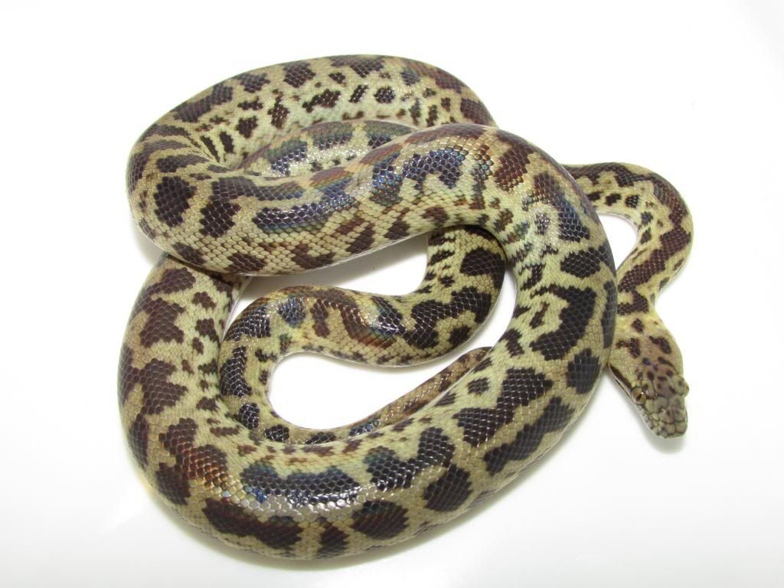

Welcome Spotted Pythons
Coding is an important skill for astrophysics
This stream is designed to learn coding at a slower pace
All examples and materials are the same across the 2 streams, but approached in different ways
Finn will be the tutor for Morelia
I am a small friendly snake!
If you have any questions, ask in tutorials, on the forum or via email
(michelle.ding@unsw.edu.au)

Slide 3


Welcome Spotted Pythons
Coding is an important skill for astrophysics
This stream is designed to learn coding at a slower pace
All examples and materials are the same across the 2 streams, but approached in different ways
Finn will be the tutor for Morelia
I’ll see you next week

Slide 4
Michelle (she/her)
2nd year PhD student
Wanted to be a singer before I was 11
Decided to be an astronomer after I watched a documentary about Black Holes

Slide 5



Michelle (she/her)
Started university and jumped around multiple research groups
Prof Dennis Stello – Pipeline to distinguish between good and bad data
A. Prof Kim-Vy Tran – Strong lensing in group environments
Dr Jesse van de Sande – Chemical structures in edge-on galaxies
I love teaching, singing, dancing, travelling, going to markets, and seeking out good vegetarian food (ask me for any restaurant suggestions)

Slide 6
I want to hear from you
What is your name
What part of astronomy are you most excited about to learn/most interested in?
Please give me feedback. I want you to govern what these tutorials are about!

Slide 7

Reminders
The computational assignment involves collaboration
Weekly meetings with <50% attendance (I will allocate time for these during the tutorial)
Meeting minutes uploaded to GitHub as a Markdown
Minimum 3 lines of code committed to GitHub by each member
Every week until submission in Week 7
We may ask you to explain your code to us
Responsible AI use
AI references can be wrong
Everything you write can be examinable
All materials covered in the tutorials can be examinable
We can tell AI-generated code apart from originally written code

Slide 8

Why use GitHub
Backup of code to reduce the chances of you losing your work
Version control
Automation tools for building and testing your work
Store and present documentation
Recognition for your work
If you are confused by my GitHub tutorial, refer to the following links (there are different ways to setup GitHub):
https://adacs-australia.github.io/2023-03-20-Coding-Best-Practices-Workshop/GitHub/index.html
https://code.visualstudio.com/docs/sourcecontrol/github

Slide 9
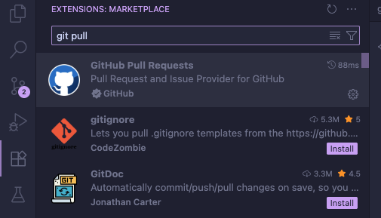
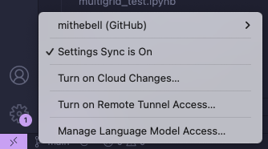
Setting up GitHub
Sign up for a free account: https://github.com/
Install VS Code: https://code.visualstudio.com/
Check you have git installed on your machine
Mac and Linux should have Git installed by default
Open Terminal or Windows command prompt
Type git version
If Git is not installed, it will alert you that git is an unknown command
Install Git and GitHub integration in VS Code
https://git-scm.com/downloads
Install the GitHub Pull Requests and Issues extension (Please check you have Git)
Sign in with your GitHub account

Slide 10

Setting up GitHub
Set up git for the first time on your computer:
Return to the terminal and type the following (with your email)
Creating a GitHub repository from a local folder
Log in to GitHub, then click on the icon in the top right corner

Slide 11
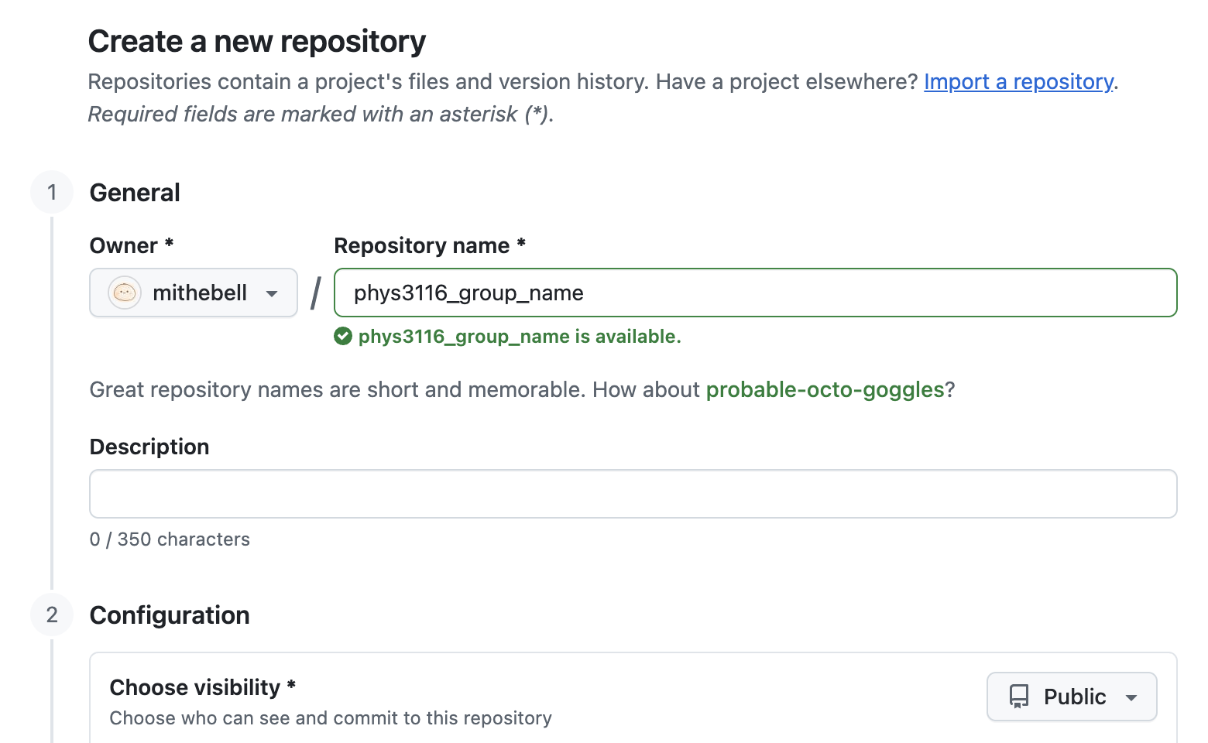
Setting up GitHub
Make your repository name as a group, make it public, and add a README

Slide 12
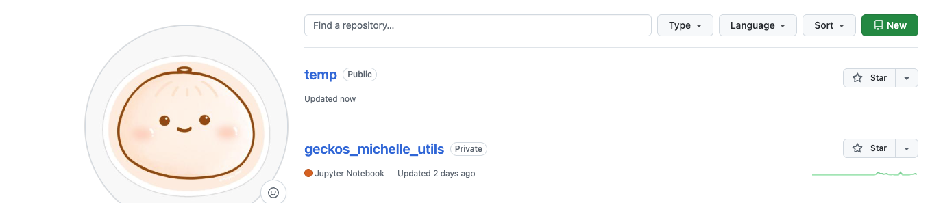

Setting up GitHub
Check that you have your repository on your profile
Return to VS Code, and type >Git: Clone in the Command Palette
Choose Clone from GitHub, and select the repository you want to clone
Make a new folder where you want to keep your code and select it as the repository destination
Go back to the Command Palette and type >Git: Initialize Repository
You can now start committing to GitHub

Slide 13
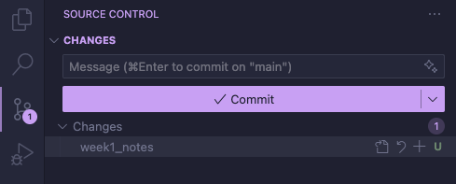
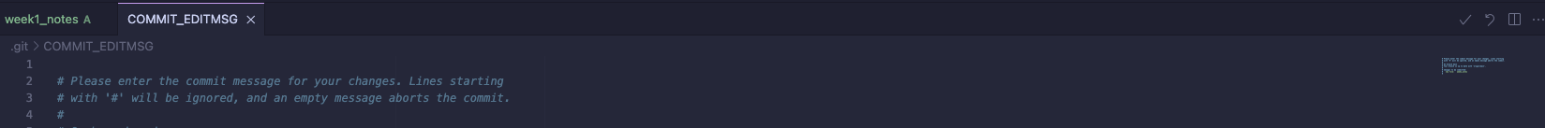
Setting up GitHub
Staging and committing code
Go to Source Control
Add the changes you want to commit, and press commit
Write a short description of what you are committing and press the tick in the upper right corner

Slide 14
Setting up GitHub
Staging and committing code
Sync your changes and check you have your new code/files on GitHub
Adding collaborators
Go to the settings of your repository, and select Collaborators
Invite your group mates
Clone the repository for the other collaborators
Be careful about changing the code at the same time
I recommend communicating when code has been changed
If you are advanced, use branches

Slide 15
Markdown
Text-to-HTML conversion tool
Can be used in Jupyter Notebooks for annotation of code
Allows mathematical expressions in LaTeX-style syntax
Cheat sheet: https://www.markdownguide.org/cheat-sheet/
Exercise 1: Find your group and write your meeting notes in a Markdown file. Then upload it to GitHub
Element | Markdown Syntax
Heading | # Heading 1
Bold | **Bold text** or __Bold text__
Italic | *Italic text* or _Italic text_
Highlight | ==Highlighted text==
Unordered List | - First item
Link | [title](https://www.example.com)

Slide 16
BODMAS with Python
Operators in Python are applied much like the rules we learnt in primary school. Specifically:
() Brackets
** (not ^) Exponentiation
*, /, //, % Multiplication, Division, Floor Division, Modulus
+, - Addition, Subtraction
We will start exercises next week when the streams are split
Note:
Using comments and easily interpreted variable names makes code easier to read. But make sure your variable name starts with a letter and is not a reserved word within Python.

Slide 17

Modules
A file containing Python definitions and statements that can be imported into another script
Common modules and how they are imported:
import numpy as np
Manipulation of arrays
import matplotlib.pyplot as plt
Create static, animated and interactive visualisations
from astropy.io import fits
Contains range of tools for astronomical computations
FITS (Flexible Image Transport System) is a digital file format containing multi-dimensional arrays

Slide 18
Data Types
A file of different data types:
Cannot add or subtract strings with an integer
To work with the data types, you can convert them into the same type
Data Type | Meaning
Integer | No decimal point
Floating point | With decimal
Complex number
String | Text

